Slide 1
PERT Analysis
Presented By: Pratibh Acharya
Bhawana Dahal

Slide 2
Introduction
PERT(Program/Project Evaluation and Review Technique) is a statistical tool.
It is used in Project Management.
It was designed to analyze and represent the tasks involved in completing a given project.
It was developed by the United States Navy, used in conjunction with Critical Path Method(CPM).

Slide 3
History- PERT
PERT was developed by the US Navy in 1950.
It was designed for the planning and control of the Polaris missile program and the emphasis was on completing the program in the shortest possible time.
PERT has the ability to cope with uncertain activity completion times.

Slide 4
CPM
CPM(Critical Path Method) is an algorithm for scheduling a set of project activities.
In CPM activities are shown as a network of precedence relationships using activity-on-node network construction.

Slide 5
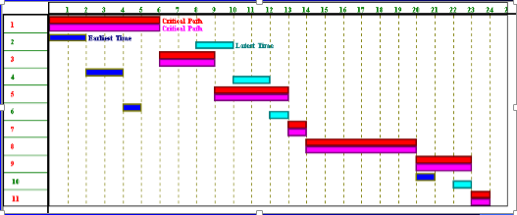
Why CPM/PERT is used?
Let us look at the Gnatt Chart.
They provide an easy graphical representation of when activities (might) take place.

Slide 6
But …
Gnatt Chart
do not clearly indicate details regarding the progress of activities.
do not give a clear indication of interrelationship between the separate activities.

Slide 7
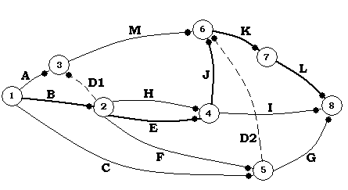
Continued …
These deficiencies can be eliminated to a large extent by showing the interdependence of various activities by means of connecting arrows called network technique.
Overtime CPM and PERT became one
technique.

Slide 8
Benefits of CPM/PERT
Useful at many stages of project management
Mathematically simple
Give critical path and slack time
Provide project documentation
Useful in monitoring costs

Slide 9
Questions Answered by CPM & PERT
Completion date?
On Schedule?
Within Budget?
Critical Activities?
How can the project be finished early at the least cost?

Slide 10
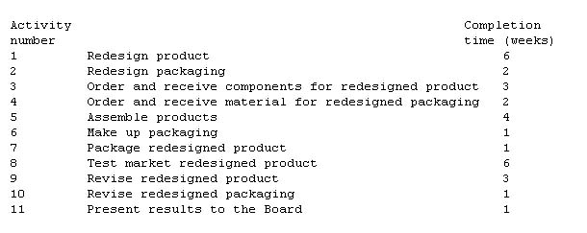
Example
Let us take an example which deals with the redesign of a product and its associated packaging.

Slide 11
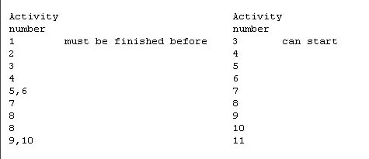
For clarity, this list is kept to a minimum by specifying only immediate relationships, that is relationships involving activities that "occur near to each other in time".

Slide 12
Before starting any of the above activity, the questions asked would be
could we complete this project in 30 weeks?
could we complete this project in 2 weeks?
One answer could be, if we first do activity 1, then activity 2, then activity 3, ...., then activity 10, then activity 11 and the project would then take the sum of the activity completion times, 30 weeks.
“What is the minimum possible time in which we can complete this project ? “

Slide 13
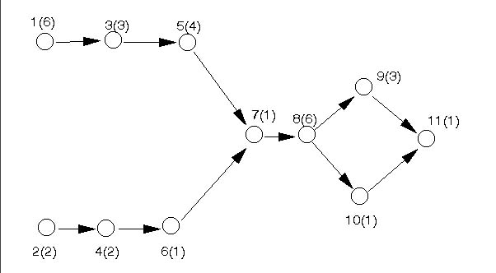
We shall see below how the network analysis diagram/picture we construct helps us to answer this question.

Slide 14
Critical Path takes 24 weeks for the completion of the project.

Slide 15
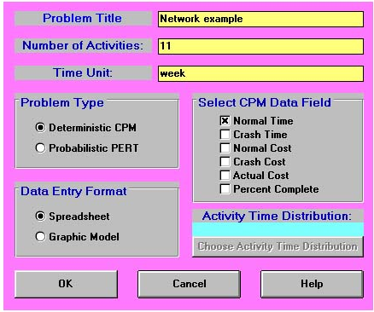
Packages are available to determine the shortest path and other relevant information.

Slide 16
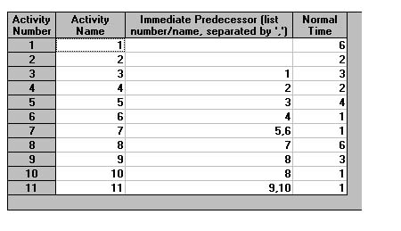
Data entry window

Slide 17
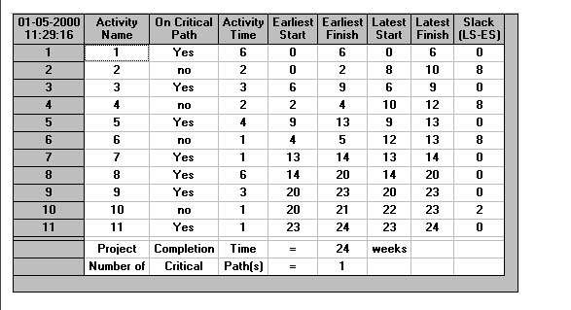
Output of the package

Slide 18
Limitations to CPM/PERT
Clearly defined, independent and stable activities.
Specified precedence relationships.
Over emphasis on critical paths.

Slide 19
Thank You

